Slide 1
Factory Pattern

Slide 2
Pattern Taxonomy
Pattern
Creational
Pattern
Structural
Pattern
Behavioral
Pattern
Factory
Factory
Singleton
Command
Mediator
Observer
Strategy
Strategy
Adapter
Bridge
Facade
Proxy

Slide 3
Factory Patterns
Creational patterns:
  Make it easier to construct complex objects
  Hide complexity of creation and eliminate repetitive code.
  Easy to extend (Open for extension)
Class creational pattern:
  Makes use of inheritance to decide the object to be instantiated
  Factory method pattern
Object creational pattern:
  Concerns delegation of object instantiation to another object
  Abstract factory

Slide 4
“New” is Closed for Modification
Use of new operator to directly instantiate a concrete class:
  Makes the program closed for modification
That may be fine when things are simple, but . . .

Slide 5
Factory Rationale
Why use a Factory?
  Create new objects without explicitly using the new operator.
  Can facilitate instantiation of other newly-derived classes.
  Can initialize and configure the created object.
Factories are singletons:
  An application typically needs only one instance of a ConcreteFactory per product family.

Slide 6
Simple Factory Pattern
Factory:
  A class whose sole job is to easily create and return instances of other classes
Instead of calling a constructor:
  Use a static method in a "factory" class
  Saves clutter and complexity and improves flexibility
Examples in Java:
  borders (BorderFactory),
  key strokes (KeyStroke),
  network connections (SocketFactory)

Slide 7

How does Simple Factory Work?
<abstract>
Product
<static>
ProductFactory
createProduct(param) : Product
inherits
<Implementation Class>
ProductA
<Implementation Class>
ProductB
Produces different subclasses of Product according to parameters

Slide 8
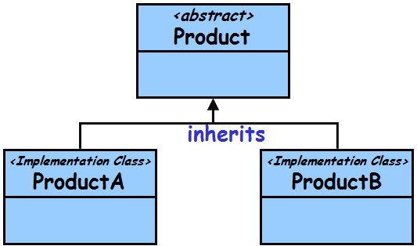
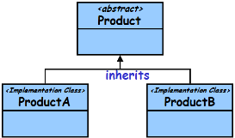
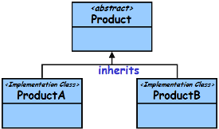
Factory Variations
Three main Variants:
Simple Factory:
  Returns an object of a class from a class hierarchy
Factory Method pattern:
  Produces objects of one type
  Uses an overridable method to create its objects
  Subclassed to make new kinds of factories
Abstract Factory pattern:
  Produces objects of many different types (families)

Slide 9
Pizza orderPizza() {
Pizza pizza = new Pizza(); //Base
pizza.garnish();
pizza.bake();
pizza.cut();
pizza.box();
return pizza;
}
Motivation for Simple Factory

Slide 10
Pizza orderPizza(String type) {
Pizza pizza;
if (type.equals(“cheese”)) {
pizza = new CheesePizza();
} else if (type.equals(“greek”)) {
pizza = new GreekPizza();
} else if (type.equals(“pepperoni”)){
pizza =new PepperoniPizza(); }
pizza.garnish();
pizza.bake();
pizza.cut();
pizza.box();
return pizza;
}

Slide 11
Pizza orderPizza(String type) {
Pizza pizza;
if (type.equals(“cheese”)) {
pizza = new CheesePizza();
} else if (type.equals(“greek”)) {
pizza = new GreekPizza();
} else if (type.equals(“pepperoni”)) {
pizza = new PepperoniPizza();
} else if (type.equals(“sausage”)) {
pizza = new SausagePizza();
} else if (type.equals(“veggie”)) {
pizza = new VeggiePizza();
}
pizza.prepare();
pizza.bake();
pizza.cut();
pizza.box();
return pizza;
}
Closed for changes!
Encapsulate
Want to introduce new base pizzas…

Slide 12
public class SimplePizzaFactory {
public static Pizza createPizza(String type) {
Pizza pizza;
if (type.equals(“cheese”)) {
pizza = new CheesePizza();
} else if (type.equals(“pepperoni”)) {
pizza = new PepperoniPizza();
} else if (type.equals(“sausage”)) {
pizza = new SausagePizza();
} else if (type.equals(“veggie”)) {
pizza = new VeggiePizza(); }
return pizza;
}
}
Motivation for Simple Factory
Now orderPizza() would be tidy

Slide 13
public class PizzaStore {
SimplePizzaFactory factory;
public Pizza orderPizza(String type) {
Pizza pizza;
pizza = factory.createPizza(type);
pizza.garnish();
pizza.bake();
pizza.cut();
pizza.box();
return pizza;
}
}
No new operator

Slide 14
Pizza Factory Class Diagram
PizzaStore
PizzaFactory
Pizza
Pepperoni
Veggie
Cheese
A Simple Factory:
  Not quite the Factory pattern, to do so we would need an abstract PizzaFactory class.

Slide 15
Simple Factory Explanation
Pull out the code that builds the instances, and put it into a separate factory class:
  Principle: Identify the aspects of your application that vary and separate them from what stays the same…

Slide 16
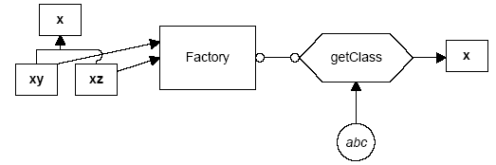
Simple Factory Pattern: Explanation
The simple Factory returns an instance of one of several possible classes depending on the data provided to it.
create
xz
Here, x is a base class:
  Classes xy and xz are derived from it.
  The Factory class decides which of these subclasses to return depending on the arguments you give it.
The create() method gets value xz, and returns an instance of the class xz.
  Which one it returns doesn't matter to the programmer since they are all of type X, but different implementations.

Slide 17
Simple Factory Pattern
Client
orderProduct()
SimpleFactory
createProduct()
<<abstract>>
Product
productMethod()
ConcreteProductA
ConcreteProductB
ConcreteProductC

Slide 18
Why Would We do This?
Two main reasons:
  Ensure consistent object initialization when multiple clients need the same types of objects.
  Open for modification

Slide 19
Case for Simple Factory: 2 Examples
Code to construct many GUI components:
homestarItem = new JMenuItem("Homestar Runner");
homestarItem.addActionListener(this);
viewMenu.add(homestarItem);
crapItem = new JMenuItem("Crappy");
crapItem.addActionListener(this);
viewMenu.add(crapItem);
Another example (with buttons):
button1 = new JButton();
button1.addActionListener(this);
button1.setBorderPainted(false);
button2 = new JButton();
button2.addActionListener(this);
button2.setBorderPainted(false);

Slide 20
Factory Example 1
public class ButtonFactory {
private ButtonFactory() {}
public static JButton createButton(
String text, ActionListener listener, Container panel){
JButton button = new JButton(text);
button.setMnemonic(text.charAt(0));
button.addActionListener(listener);
panel.add(button);
return button;
}
}

Slide 21
Simple Factory Advantages…
Creation of buttons etc. by an application object:
  Avoids significant duplication of code.
  Makes the client class work at a suitable level of abstraction as these may not be part of the composing object's concerns.

Slide 22
public class SimplePizzaFactory {
public static Pizza createPizza(String type) {
Pizza pizza;
if (type.equals(“cheese”)) {
pizza = new CheesePizza();
} else if (type.equals(“pepperoni”)) {
pizza = new PepperoniPizza();
} else if (type.equals(“sausage”)) {
pizza = new SausagePizza();
} else if (type.equals(“veggie”)) {
pizza = new VeggiePizza(); }
return pizza;
}
}
Draw Class Diagram for Simple Factory

Slide 23
Simple Factory
Shortcomings?
Step 1
Child
Class A
Step 2
<<create>>
Client
Simple Factory
Child
Class B
Parent class
or
Interface
<<create>>
<<create>>
Child
Class C
Step 3

Slide 24
Simple Factory: Working
Step One:
  Call the static create method of factory.
  The parameters tell the factory which class to create.
Step Two:
  The factory creates required object.
  Note that the objects have the same parent class, or implement the same interface.
Step Three:
  Factory returns the object.

Slide 25
Problems with Simple Factory
Simple factory makes the application unaffected by changes
But the factory itself needs changes each time a new class needs to be instantiated…
Solution: Factory method:
  Subclass the factory!

Slide 26
Need a Factory Method!
Client
Step 4
Concrete Creator 1
+create()
Child
Class A
Step 1
Creator
<<abstract>>
+method1
+method 2
+Create(Abstract)
The Factory Method!!!
Parent class
or
Interface
Step 2
Concrete Creator 2
+create()
Child
Class B
Step 3

Slide 27
Factory Method
Step One:
  The client maintains a reference to the abstract Creator, but instantiates it with one of the subclasses. (i.e. Creator c = new ConcreteCreator1(); )
Step Two:
  The Creator has an abstract method for creation of an object, which we'll call "Create".
  All child classes must implement “Create”.
Step Three:
  The concrete creator creates the concrete object.
Step Four:
  The concrete object is returned to the client.

Slide 28
Factory Method: Example
PizzaStore
createPizza()
orderPizza()
NYStylePizzaStore
createPizza()
ChicagoStylePizzaStore
createPizza()

Slide 29
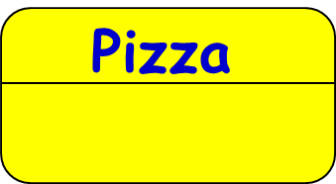
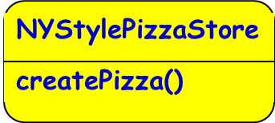
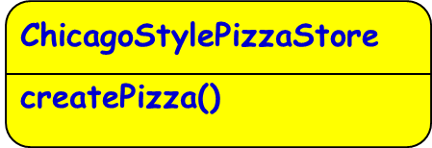
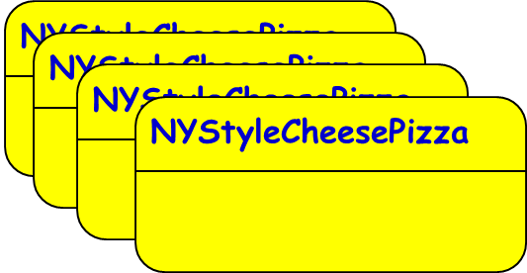
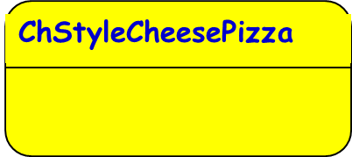

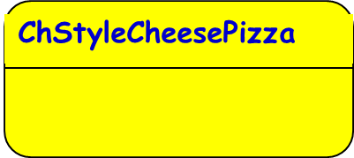
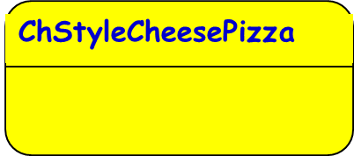
Factory Method: Example
PizzaStore
createPizza()
orderPizza()
Creator Classes
Product Classes

Slide 30
Example: Pizza Store
Pizza
Store
Pizza is an
abstract class
Pizza
Pizza
Pizza
Pizza
Chicago
Cheeze
Pizza
NyStyle
Cheeze
Pizza
Chicago
Cheeze
Pizza
NyStyle
Cheeze
Pizza
Chicago
Cheeze
Pizza
NyStyle
Cheeze
Pizza
Chicago
Clam
Pizza
NyStyle
Clam
Pizza

Slide 31
Factory Method Pattern Defined
The factory method pattern defines an interface for creating an object:
  But leaves it to subclasses regarding which class to instantiate.
  Factory method lets a class defer instantiation to subclass.

Slide 32
Factory Method: Class Structure
AbstractCreator
FactoryMethod()
AnOperation()
<<interface>>
Product
ConcreteProduct1
<<create>>
ConcreteCreator
FactoryMethod()

Slide 33
Factory Method Pattern
Define an interface for creating an object,
  but let subclasses decide which class to instantiate.
Factory Method lets a class defer instantiation to subclasses.
AbstractCreator
FactoryMethod()
AnOperation()
Product =
FactoryMethod()
<<interface>>
Product
ConcreteProduct1
<<create>>
ConcreteCreator
FactoryMethod()
return new
ConcreteProduct()

Slide 34
Participants
Product: defines the interface for objects the factory method creates.
ConcreteProduct: implements the Product interface.
Creator(aka Factory): is an abstract class
  Declares the method FactoryMethod, which returns a Product object.
  Calls the generating method for creating Product objects .
ConcreteCreator: overrides the generating method for creating ConcreteProduct objects

Slide 35
AbstractProduct
public interface Product { � }
public abstract class Creator {
protected abstract Product factoryMethod();
}
public class ConcreteProduct implements Product { � }
public class ConcreteCreator extends Creator {
protected Product factoryMethod() {
return new ConcreteProduct(); } }
public class Client {
public static void main( String arg[] ) {
Creator c = new ConcreteCreator();
Product p= c.factoryMethod();
}
}
ConcreteProduct1
Factory Method Generic Code

Slide 36
Factory Method Capabilities
Factory Method gives subclasses a hook for providing extended versions of an object.
  New product objects can be initialized.
Product class bindings can be deferred until runtime.

Slide 37
Factory Method: Example 1
We need to create an application that can read and present multiple documents.
Two key abstractions
  Application
    Create and Manage Document
  Document
    Specific type of documents

Slide 38
Factory Method
We want to support a wide variety of applications:
  Text editors
  Word processors
  Vector drawing applications
  Document Viewers
Our application be able to manage the documents.

Slide 39
Document Presenter Application Example
Application
Document {abstract}
{abstract}
0..* 0..1
The Factory Method
+CreateDocument(): bool
+NewDocument(): bool
+OpenDocument(): bool
TextDocument
ImageDocument
DrawingApplication
ImagzipApplication

Slide 40
public abstract class Document {
public abstract void open();
public abstract void close(); }
public abstract class Application {
private List docs = new ArrayList();
public void newDocument() {
Document doc = createDocument();
docs.add(doc);
doc.open(); }
... public abstract Document createDocument(); // factory method
}

Slide 41
public class TextDocument extends Document { … // implementation of the abstract methods }
public class MyApplication extends Application
{
  public Document createDocument() {
  return new TextDocument();
  }
}

Slide 42
Document Presenter Application Example
Application
Document {abstract}
{abstract}
0..* 0..1
+CreateDocument(): bool
+NewDocument(): bool
open()
save()
TextDocument
ImageDocument
TextApplication
DrawingApplication
+CreateDocument()
+NewDocument()
+CreateDocument()
+NewDocument()

Slide 43
Exercise
A Composite document contains several types of documents such as graphics, Spreadsheet, CAD application, CASE tool application, etc.
  Double clicking on a specific type of document should bring up the corresponding Editor (manipulator)
Give the class diagram of your solution.

Slide 44
Document
Manipulator
Client
createManipulator()
drag()
……..
Graph
Spreadsheet
GraphManipulator
SSManipulator
createManipulator()
createManipulator()
<<create>>
<<create>>

Slide 45
The Factory Method: Applicability
You should consider using a Factory method pattern when:
  Not possible anticipate which kind of objects must be created.
  Choice may depend on:
    The state of the running application.
    User input.
    Changes or enhancements.
  The objects to be created are instances of classes that form a hierarchy.

Slide 46
Advantages of Factory Method Pattern
Separates responsibility of complex creation into cohesive helper classes
  Hides complex creation logic, such as initialization from a file
  Create classes of hierarchy of objects as required
The client of Creator can ask for the production of different Products in a uniform way:
  And use them uniformly
  Without knowing the nitty-gritty details

Slide 47
The Factory Pattern: Pros and Cons
Factory pattern introduces separation between the application and a family of classes:
  It removes tight coupling by hiding concrete classes from the application.
It provides a simple way to extend the family of products with minor changes in application code.
When the objects are created directly inside the class:
  It's hard to replace them by objects which extend their functionality.
  When a factory is used one can easily replace the original objects, configuring the factory to create them.

Slide 48
Known Uses
It is a pervasive pattern.
It is used in several places in the Java API.
  For example, URLConnection has a method getContent that returns the content as an appropriate object (html, gif etc.)
In .Net Framework Class Library, the Factory method is used in:
  Systems.Collections.IEnumerable,
  System.Net.WebRequest
  System.Security.Cryptography

